Slide 1



PY-EXPO 2026
Team Name – SMART DROP
Problem Statement ID - PY0129
Problem Statement Title- SMART FLOW SYSTEM
Domain-IOT
PS Category-Hardware
Industry Mentor –SRIRAM R
Student Mentor -ANISH KARTHIC

Slide 2
TEAM DETAILS
S.No. | DEPARTMENT | ROLL NO | Role | NAME
1 | R&A | 25URA137 | Team Lead | Mohamed Arshath M
2 | AIML | 25UAM235 | Team Member | Sanjay K
3 | CYS | 25UCY152 | Team Member | Sonika M
4 | IT | 25UIT248 | Team Member | Vaisika P
5 | CSE | 25UCS212 | Team Member | Rakshitha K S
6 | AI&DS | 25UAD235 | Team Member | Sai Ragavi A C
7 | student mentor name : Anish Karthic

Slide 3
SMART FLOW SYSTEM
Proposed Solution:
How the Issue Is Solved:
The Smart Irrigation System automatically checks soil moisture using sensors and an ESP32 to supply water only when needed. It includes a web dashboard for easy monitoring and control. This system reduces water wastage, avoids overwatering and manual work, and improves crop growth. Its uniqueness lies in using multiple sensors, fault detection, and combining automation, monitoring, and alerts in a low-cost solution.
The problem is solved using an IoT-based system where soil moisture is continuously monitored and processed by an ESP32. The system automatically turns the pump ON when the soil is dry and OFF when enough moisture is reached, while additional sensors ensure proper water flow and detect faults.
Creativity & Feasibility:
Benefits
1.Saves water by avoiding overwatering
2.Reduces manual work
3.Improves crop growth and yield
4.Low-cost and easy to use
5.Provides real-time monitoring
Real-Time Applications
1.Agriculture fields
2.Gardens and greenhouses
3.Smart farming systems
4.Water management in farms
5.Remote irrigation control systems
The system is creative because it uses simple sensors and IoT to automate irrigation, feasible because it is low-cost and easy to build, and its MVP includes a soil moisture sensor, ESP32, relay, and pump to automatically control watering.

Slide 4
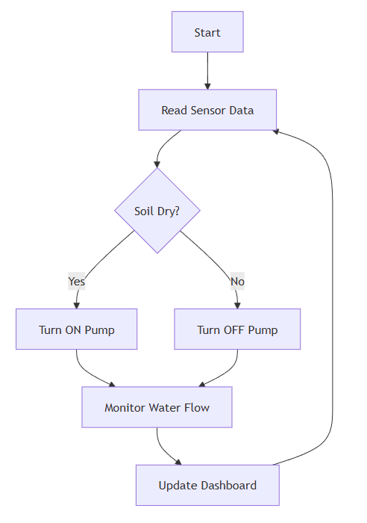
TECHNICAL APPROACH
Flow of the Project
1.Collect data from sensors
2.Send data to ESP32
3.Process data using threshold
4.Control pump ON/OFF
5.Update data to dashboard
6.Repeat continuously
Technical Stack
1.Hardware: ESP32, Soil Moisture Sensor, Water Flow Sensor, Relay, Pump
2.Software: Embedded C / Arduino IDE, Python
3.Backend: Flask (API & data handling)
4.Frontend: HTML, CSS (Web Dashboard)
5.Communication: WiFi (IoT connectivity)
Flowchart:
Methodology
The system collects soil moisture and water flow data using sensors. The ESP32 processes this data and compares it with a predefined threshold. If the soil is dry, the pump is turned ON; otherwise, it remains OFF. The data is sent to a web dashboard for monitoring and control, ensuring efficient and automated irrigation.

Slide 5

Your project
QR
Git hub

